Slide 1

Scharweb development Presents
Aventar Secure Programming
Notes:
Hello and thank you all for allowing me the opportunity to present to you, here at Aventar, our solution to keep your company's data and technology safe and secure.

Slide 2

secure programming
Why do we need it?
Secure Code is Good Code
Secure Code is the 1st Line of Defense
To Protect Your System from Takeover
To Protect Your System from Failure
To Protect Your Data
To Protect Your Customer’s Data
To Be Responsible and Keep Your Customer’s Trust
Notes:
Secure programming is the first line of defense when it comes to protecting your company’s technology.
Without it you leave anything that uses your technology vulnerable to an attack.
Your customer’s personal information could be shared.
Aventar could lose business.
The company’s confidential data could be stolen and you could even have your system taken over by an attacker.

Slide 3
Secure Design vs. Incomplete design
Properly assembled code-
Sloppy code-
Notes:
This comparison using pie charts, illustrates how code that is assembled properly fits together more tightly, leaving less room for penetration; while the code that does not include all the important secure features is not as complete and leaves room for attackers to penetrate the system.

Slide 4
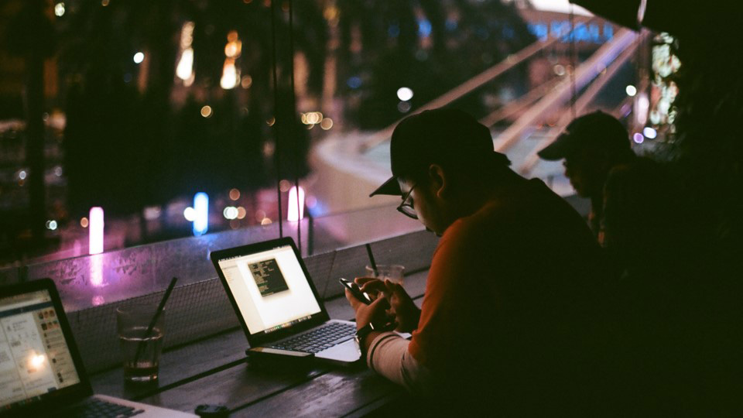
Vulnerabilities They are everywhere
Notes:
(No Speaking)
(Illustration to Drive Home the Point)

Slide 5

Vulnerabilities
Accepting User Input – Spoofing, Tampering, Repudiation,
Displaying Output – Information Disclosure,
Cross-Site Scripting
Financial Transactions
Sensitive Data Disclosure,
Repudiation, Injection
Data Transactions –
Sensitive Data Disclosure,
XXE Attack, Denial of Service
Environment –
Elevation of Privileges, Tampering
Information Disclosure,
Notes:
The system that Aventar is proposing is one of the most vulnerable because of the size of the corporation, the many points of data transfer and the sensitivity level of the information being processed.
Here you will see the points of greatest vulnerability and the greatest types of threats they entail.
There are two classifications of vulnerabilities – design related and implementation related.
But, literally, there are probably more unknown vulnerabilities than there are known ones.

Slide 6

Top 10 attacks
OWASP TOP 10 for 2017
Injection
Broken Authentication
Sensitive Data Exposure
XML External Entities (XXE)
Broken Access Control
Security Misconfiguration
Cross Site Scripting (XSS)
Insecure Deserialization
Using Components with Known Vulnerabilities
Insufficient Logging and Monitoring
Notes:
The Open Web Application Security Project, also referred to as (OWASP), is a community dedicated to the creation and use of applications and APIs that can be trusted.
Here you see a list of their top ten security risks for 2017.

Slide 7
Protection
What we suggest.
Training
Encryption
Input Validation
Multi-factor Authentication
Limit Login Attempts
Force Logout
Session Expiry
As well as following all of the regulations of PCI-DSS, The Gramm Leach Bliley Act, HIPPA, The Federal Trade and Commission Act and The Fair Credit Reporting Act/Fair and Accurate Credit Transactions Act.
Notes:
By adhering to the Security Development Lifecycle, ScharWeb Development can address Aventar’s vulnerabilities, providing the highest level of security and compliance.
Our well designed architecture will promote secure programming techniques and the highest level of dedication to ensuring a confidential and consistent flow of information.
The first step in that would be to provide quality training to everyone who has a hand in the development process so that everyone knows the importance of secure programming and how they can help to achieve it.

Slide 8
Protect against Owasp’s top 10
Threats 1-5 | Protection
Injection | The first step in preventing this is a design that keeps the sensitive data separate from commands and queries. Additional steps would include using a safe API to avoid interpreters and white-list, server-side validation.
Broken Authentication | Users of the system will be required to create strong passwords. Login attempts will be limited and multi-factor authentication will be required. Random session IDs will be used.
Sensitive Data Exposure | To prevent this from happening to Aventar’s clients, we will create a secure design that doesn’t store sensitive data unnecessarily. We will encrypt sensitive data at rest and all data in transit.
XML External Entities (XXE) | To combat this we will use less complex data formats and avoid serialization of sensitive data. We will require a patch or upgrade to all XML processors and libraries used by the application.
Broken Access Control | With the exception of public resources, access will be denied by default. We will enforce record ownership rather than allowing users to perform CRUD operations. We will also disable web server directory listings.
Notes:
“Almost any source of data can be an injection vector”. Hostile data can be used to extract sensitive information.
Authentication and session management are critical to securing your patient’s sensitive information.

Slide 9
Protect against Owasp’s top 10
Threats 6-10 | Protection
Security Misconfiguration | We will create a minimal platform for Aventar that doesn’t contain unnecessary features or components. We will ensure that all components are up-to-date and have all available patches.
Cross-Site Scripting (XSS) | ScharWeb development can use a framework to automatically escape XSS. We will also escape untrusted HTTP request data. We will use context sensitive encoding when modifying the browser document.
Insecure Deserialization | Depending on requirements, if it’s possible, we will not accept serialized objects from untrusted sources. If that’s not possible, we will require digital signatures on serialized objects and enforce type constraints.
Using Components with Known Vulnerabilities | To combat against this we will remove any unused dependencies and only obtain components from official sources over a secure link. We will monitor components and libraries for necessary security patches.
Insufficient Logging and Monitoring | Besides effective monitoring and alerting, data, such as login, access control failures and server-side input validation failures must be logged with enough information to identify malicious accounts and kept long enough for forensic investigation.
Notes:
Security Misconfiguration – The best way to combat this threat is with good, securely written code, that ScharWeb Development will provide!
Exploitation of deserialization is not that easy to do but the impact can be extreme. It can lead to remote execution attacks which are considered one of the most serious.
Most successful attacks begin with vulnerability probing.

Slide 10
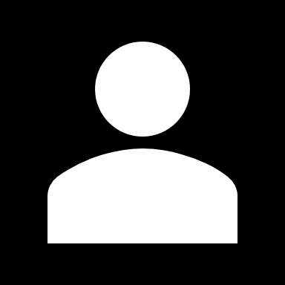
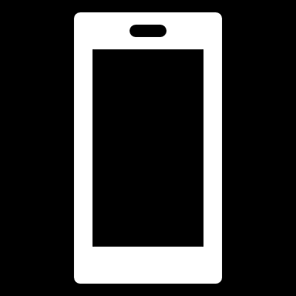
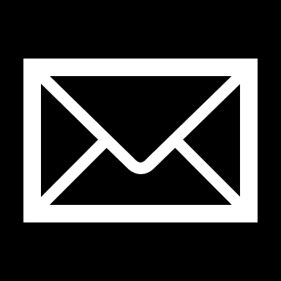
THANK YOU
WWW.SCHARWEBDEV.COM
JESSICA SCHARBER
+1 (763) 350‐2555
jessicascharber@gmail.com

Slide 11
References
Merkow, M. S., & Raghavan, L. (2015). Secure and Resilient Software Development. Retrieved from https://learning.oreilly.com/library/view/ secure-and-resilient/9781439826973/K11327_C000.xhtml
Microsoft. (n.d.). What are the Microsoft SDL practices? Retrieved July 15, 2019, from https://www.microsoft.com/en-us/securityengineering/sdl/ practices#practice1
OWASP Top 10 -2017 The Ten Most Critical Web Application Security Risks. (2017). Retrieved from https://www.owasp.org/images/7/72/ OWASP_Top_10-2017_%28en%29.pdf.pdf
Santos, R., & Geib, J. (2017, August 16). Microsoft Threat Modeling Tool mitigations. Retrieved July 15, 2019, from https://docs.microsoft.com/en-us/ azure/security/azure-security-threat-modeling-tool-mitigations
Sinclair, T. (Presenter). (2019, June 27). Module one live lecture. Speech presented at Rasmussen College, Online.
Sinclair, T. (Presenter). (2019, July 4). Module two live lecture. Speech presented at Rasmussen College, Online.

